Slide 1

Welcome to the
Library Media Center
2024-25

Slide 2
I am Mrs. Hooks.
I am here to help you.

Slide 3
Come to the LMC!
With your teacher for checkout, read aloud or lesson, research or approved computer usage.
As a class or small group for Enrichment or WIN time.
In small groups of 1-6 with a library pass.

Slide 4



Things to do in the
Library Media Center
Learning
Computer
Complete an assignment
Research
Check-in/check-out library books
Silent Reading
Lesson with Mrs. Hooks
Special event, Book Fair, Book Walk
myOn reading in
Destiny Book Search
Galileo Research
Teacher approved internet sites

Slide 5
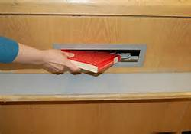
Circulation Desk
Check-in or return books into the
book drop slot.
Check-out books before leaving the LMC.

Slide 6

There are sections in our library.
Call numbers on the spines of books tell you where the book belongs
E
CAR
    Everybody fiction picture books- E
    Fiction chapter books- F, FIC
  Nonfiction information books- 000-999
        Biography 921
F
ROW
636.6
SMI
921
ALI

Slide 7
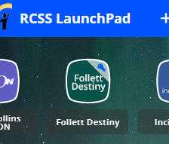


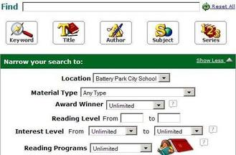
Destiny Library Catalog in LaunchPad
Search for books that we have in our library and displays your account information.

Slide 8
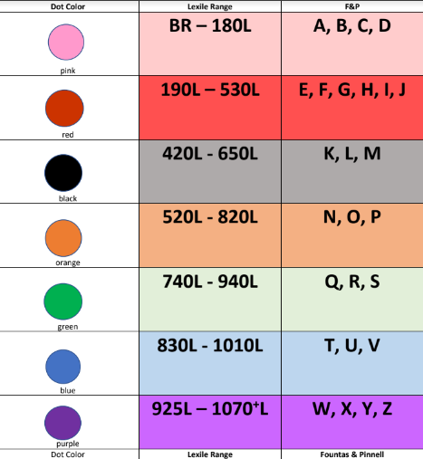
Library books use colored dots to approach your reading level.

Slide 9
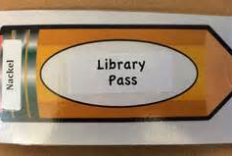
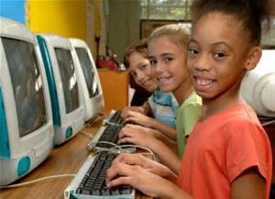
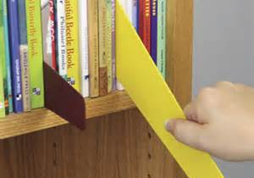
Behavior Expectations CHOMP!
Bring a library pass and enter quietly.
Use shelf markers appropriately.
Only go to approved internet sites.
Use good manners always.

Slide 10
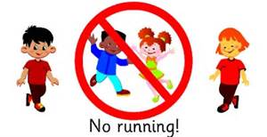
Talk quietly & use whisper voices when working in the LMC.
No candy or gum, food, or drink in the library!
Clean up and push in chairs. Pick up trash.
Walk. Do not run !

Slide 11
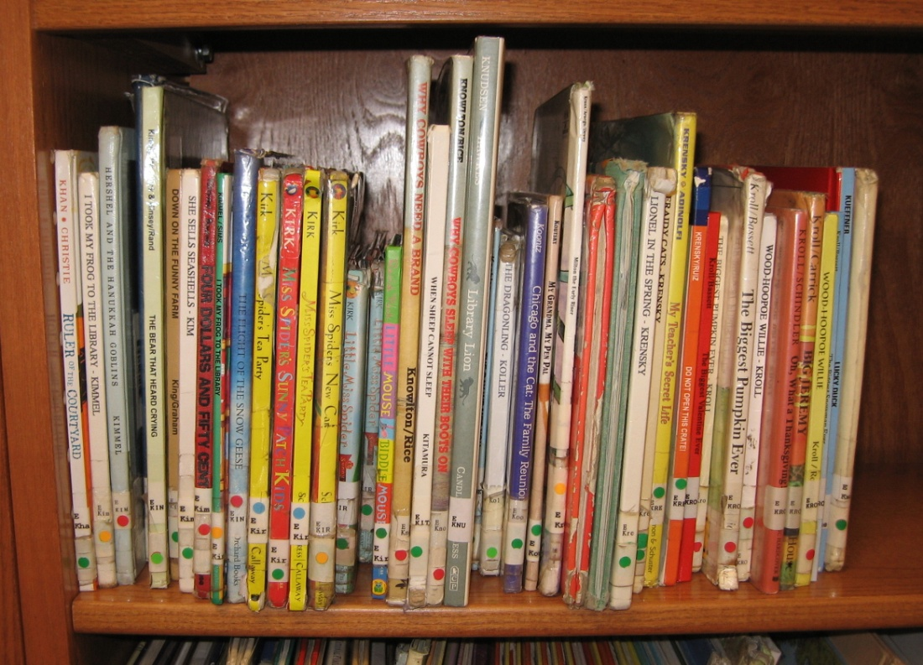
Be a Helper.
Keep the bookshelves neat!
Use shelf markers so you know where to put a book back.
Put books back on the correct shelf, standing up with the book spines facing out.
Pick-up books off the floor that have fallen.

Slide 12
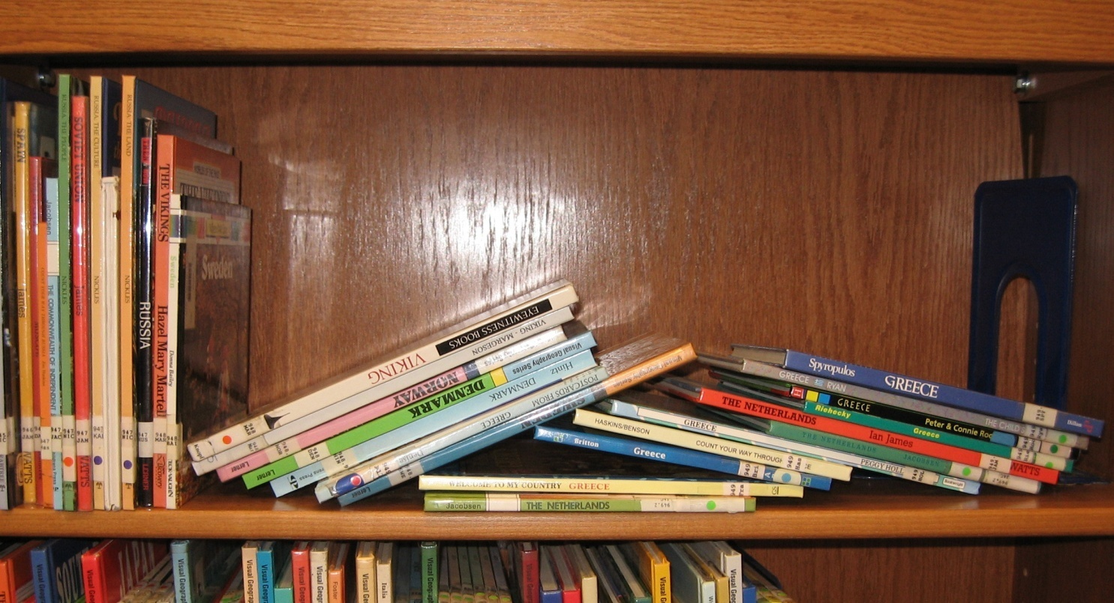
Messy Shelf Help
Push the book holder the keep books standing up.

Slide 13
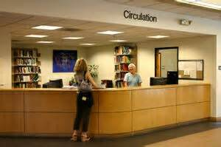
At the
Circulation Desk
Check-out before leaving the LMC.
Patiently wait in line.
Say our first and last name.

Slide 14
Book Checkout
1 or 2 books
Only 1 Graphic Novel
Due back in 3 weeks (15 class days)
Take good care of your library books and return all borrowed books.

Slide 15

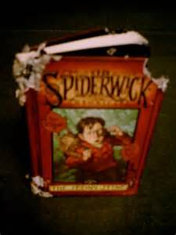
Books are damaged when…
pages are ripped
food and liquids spill on them
they are written in or marked
they are mistreated or not held properly
FINES will be applied for damaged and lost books.

Slide 16




Rewards & Consequences for your behavior
small prize, treat, happy note or sticker for GREAT GATOR conduct
warning and separation from the group
back to class and teacher notified
not allowed to checkout

Slide 17
The End

